Slide 1
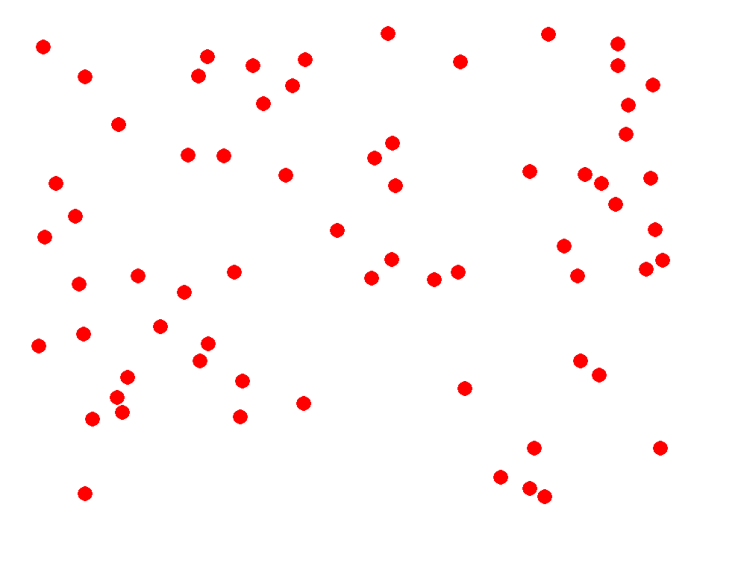
Mapping numerosity onto numbers
Ed Vul
Jess Sullivan
Dave Barner
Cog-BB 2014-06-06

Slide 2
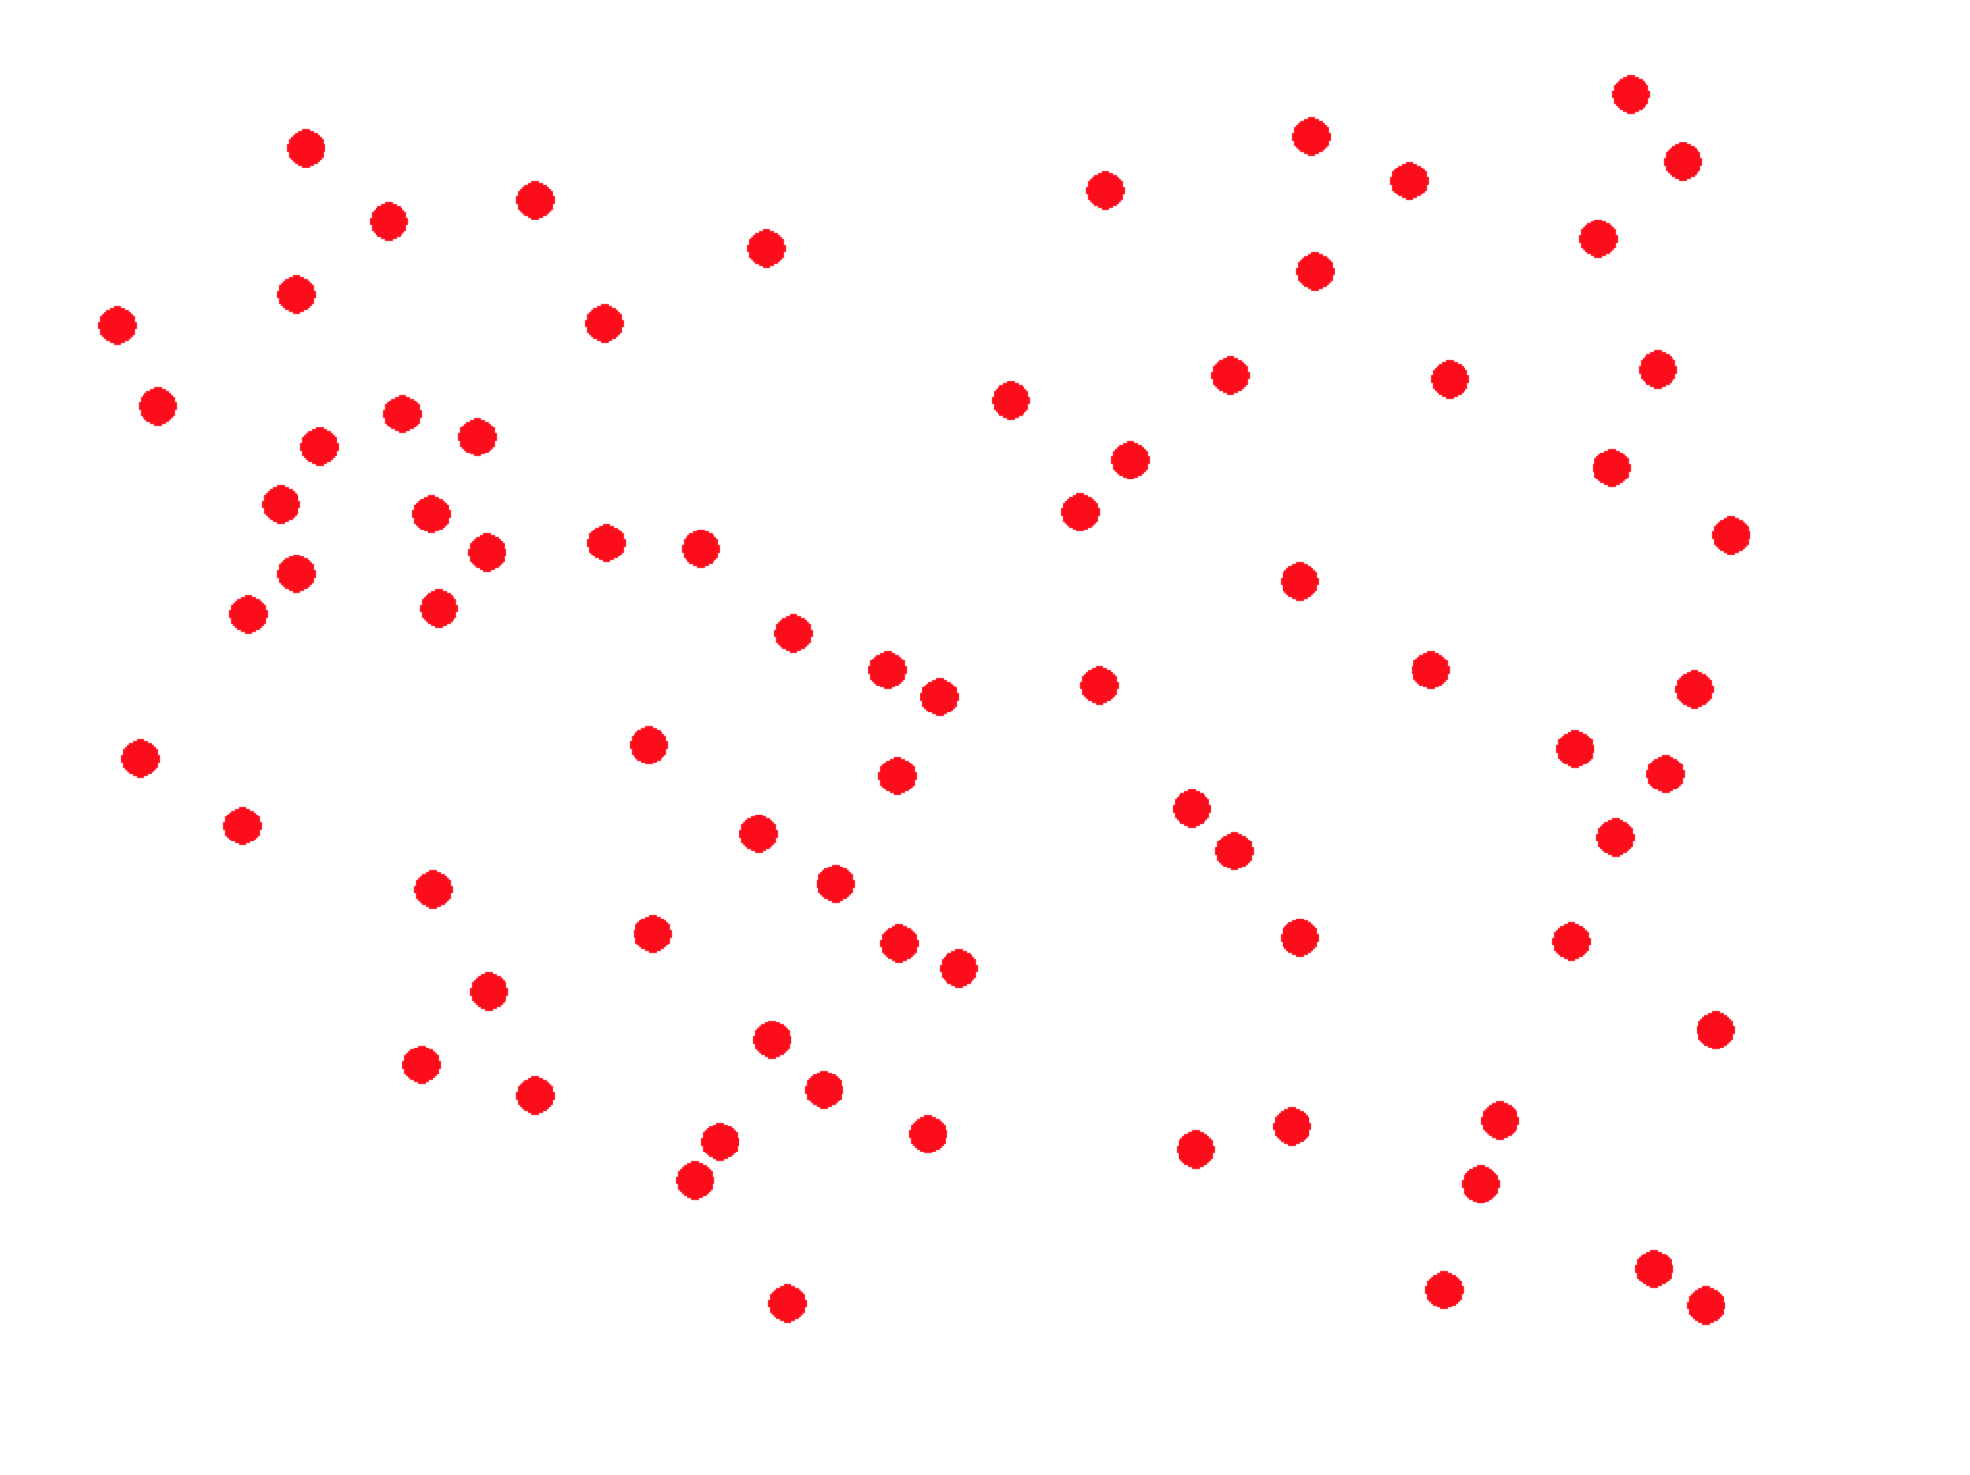
Notes:
80

Slide 3

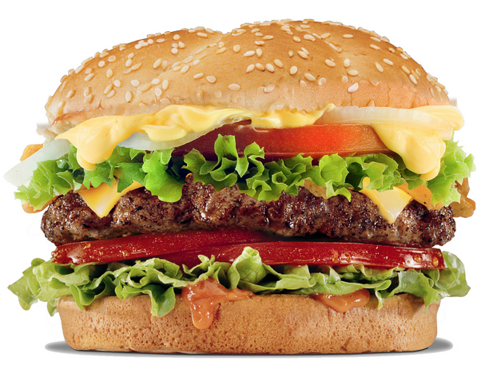
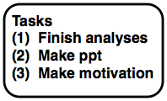
$5.80
6:30
“80”
Modern life requires mapping internal states onto formal systems and vice versa.

Slide 4
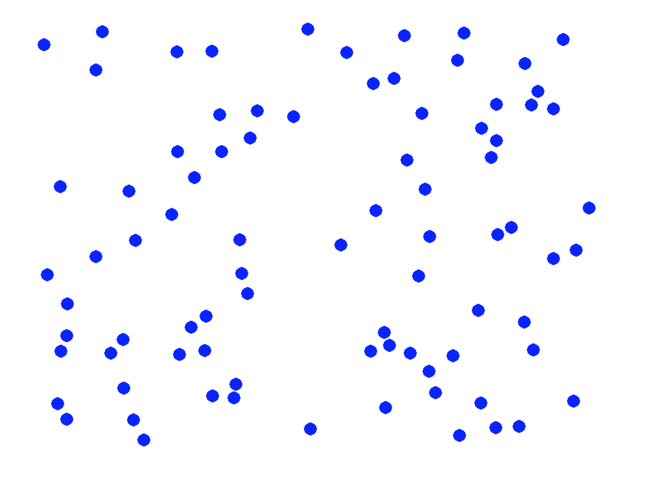
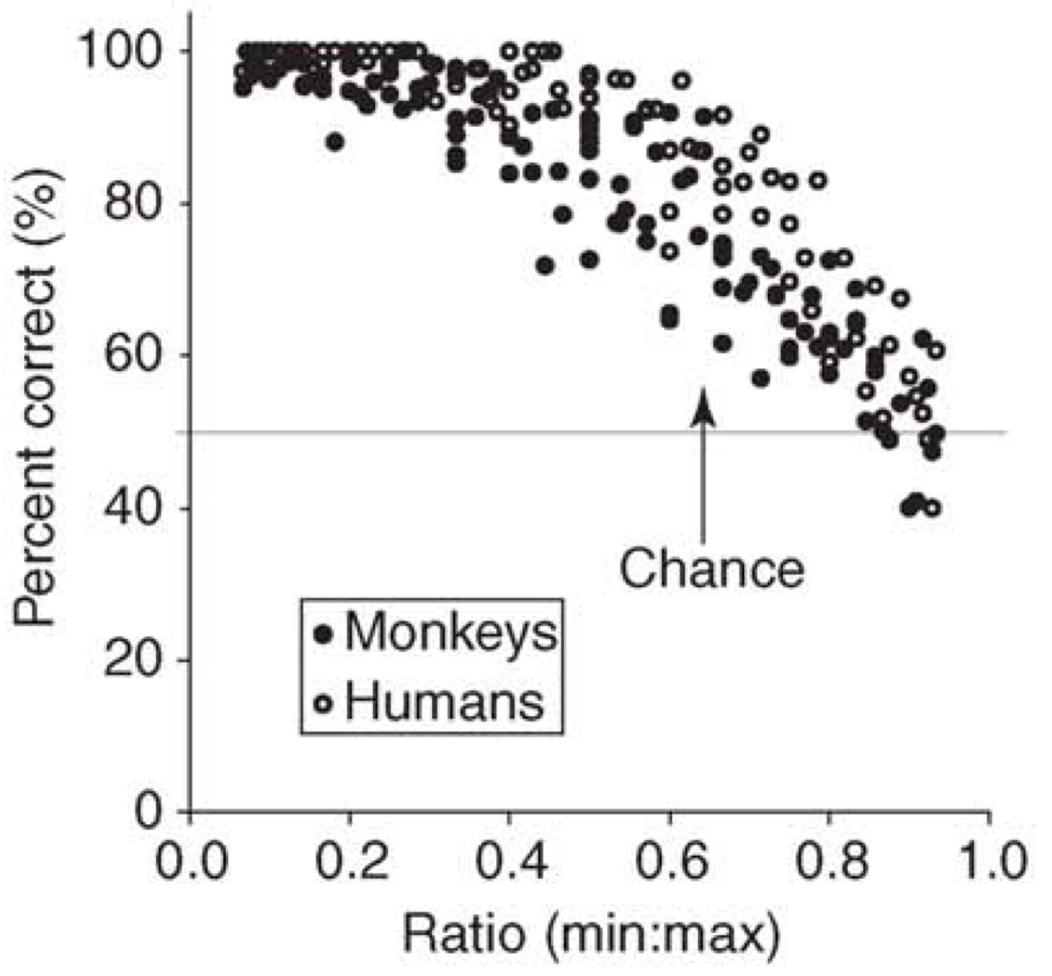
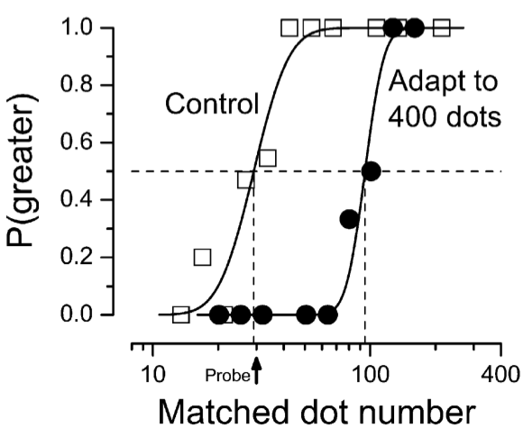
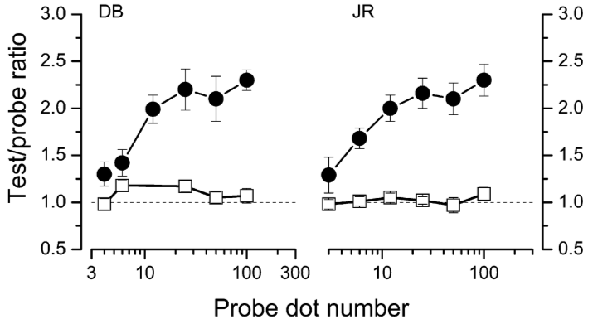
blue > red
Brannon (2006)
Burr & Ross (2008)
Relative numerosity comparisons suggest an (adaptable) Weber-Fechner representation of numerical magnitude.

Slide 5
“80”
How do we map the numerosity of an array onto a symbolic number?

Slide 6
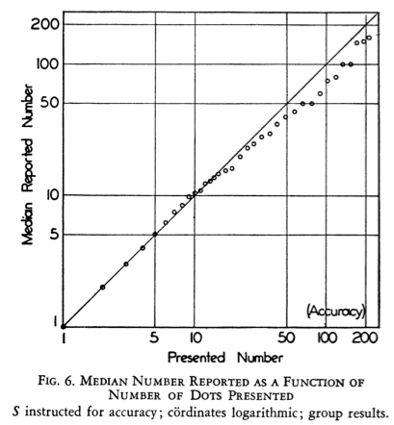
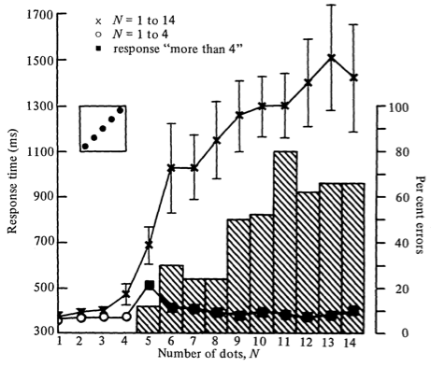
80
Kaufman et al (1949)
Atkinson et al (1976)
Misestimation follows a Stevens’ power law past a fast, error-free “subitizing” range (# < 5).

Slide 7
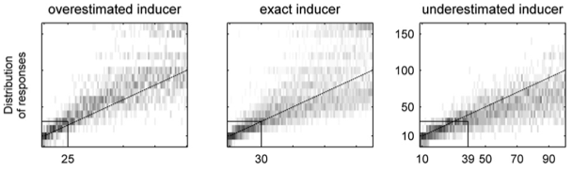
80
Izard & Dehaene (2008)
Stevens’ power-law misestimation can be recalibrated.

Slide 8
“80”
How do we map the numerosity of an array onto a symbolic number?
We map a Fechner-like magnitude representation onto space and numbers via a scalable metric.

Slide 9
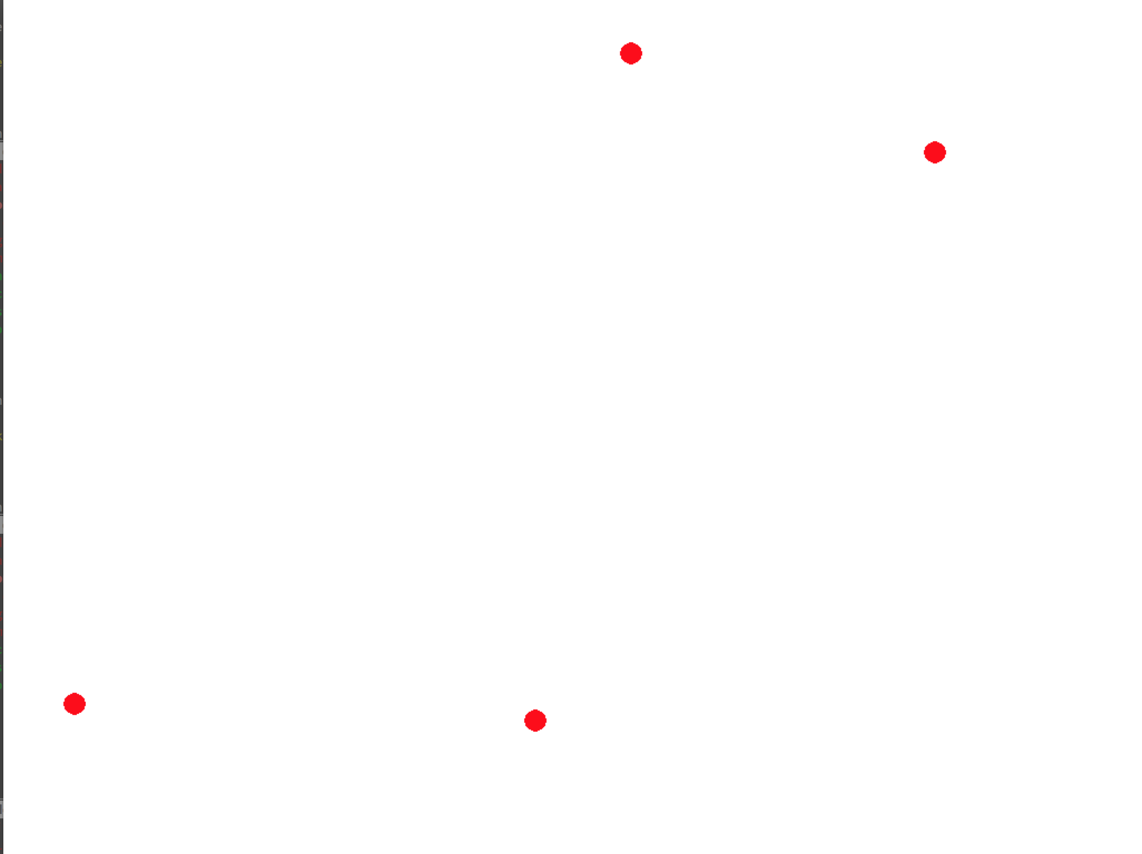
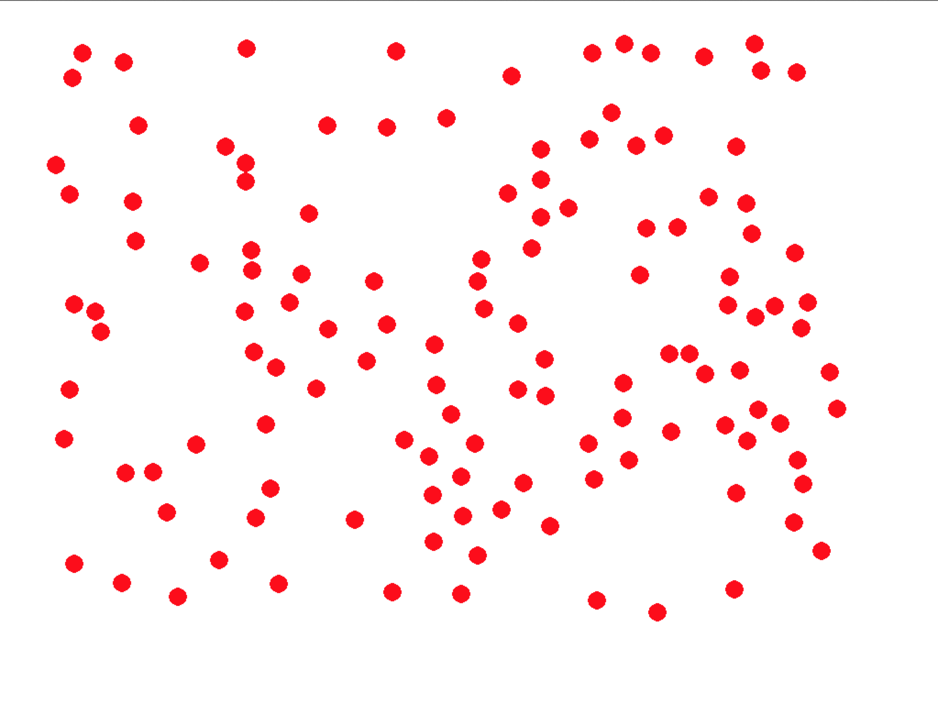
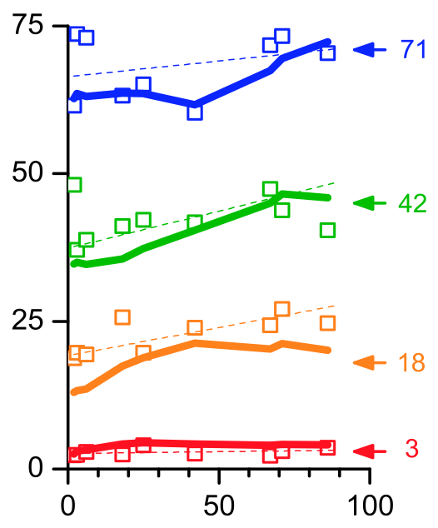
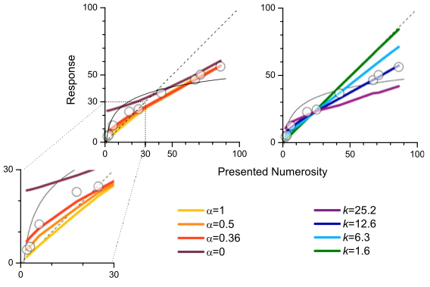
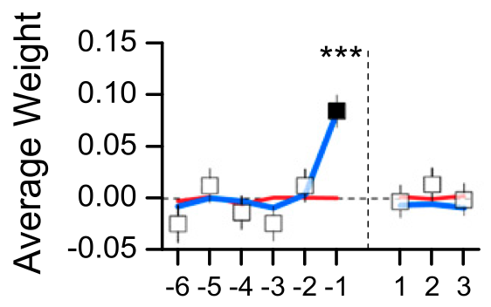
Ciccini, Anobile, & Burr (2014)
Number-space mapping is very sensitive to previous trial, suggesting that the compression arises from time averaging.

Slide 10
“80”
How do we map the numerosity of an array onto a symbolic number?
We map a Fechner-like magnitude representation onto space and numbers via a log scale.
But perhaps the compression arises only from time- averaging?
So, do we have a mapping or some kind of smoothing?

Slide 12
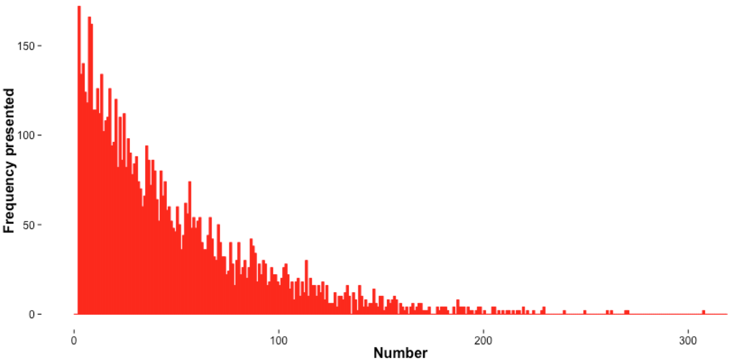
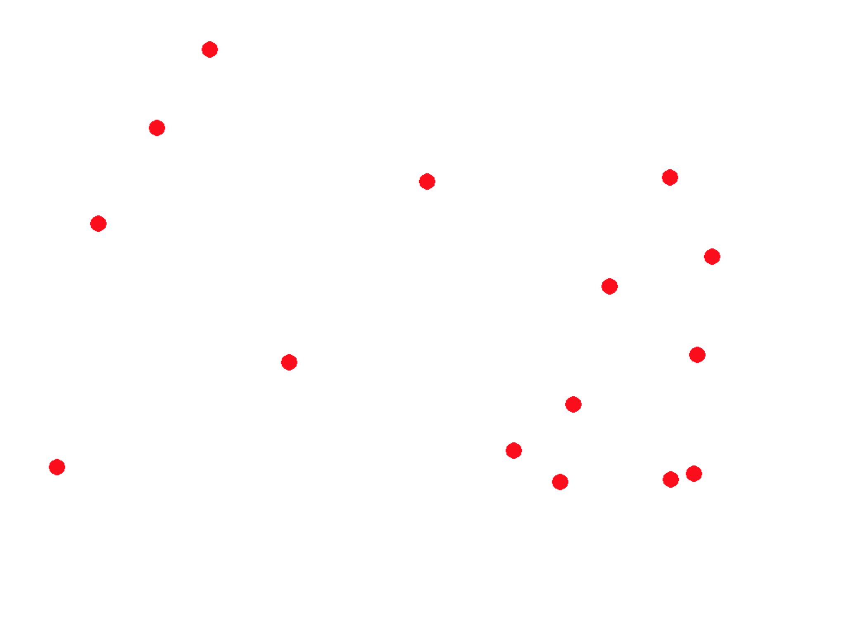
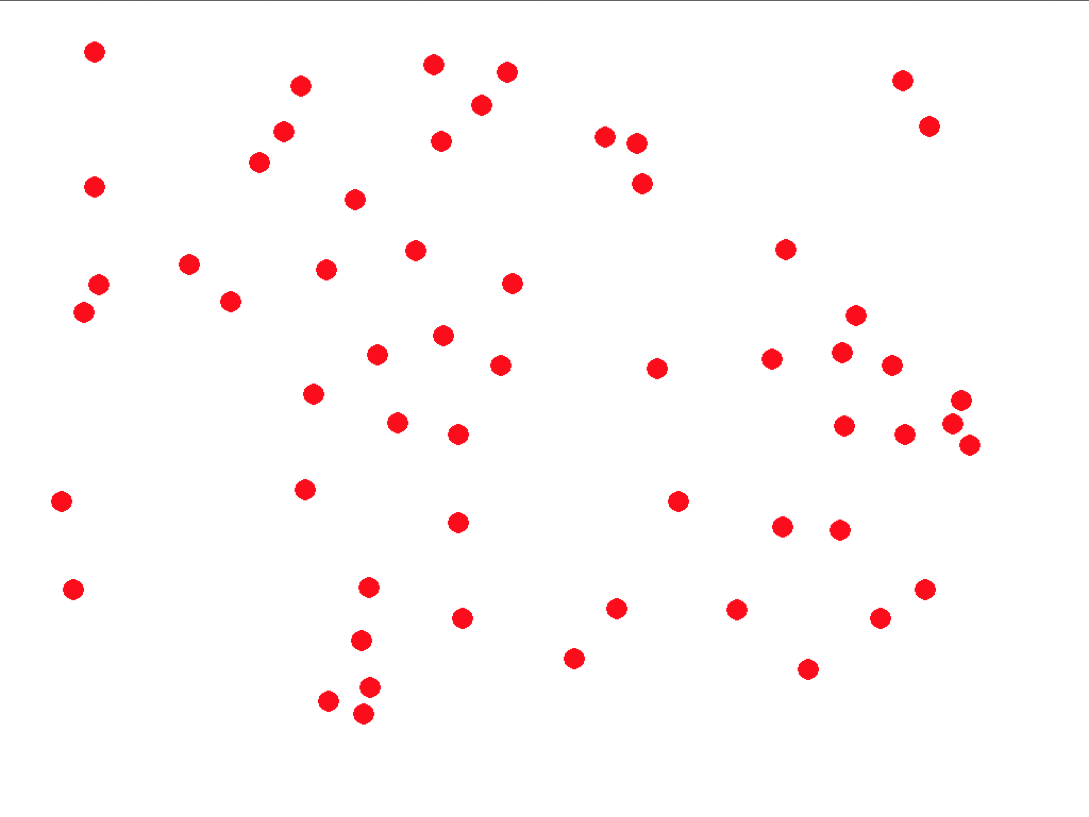

Slide 13
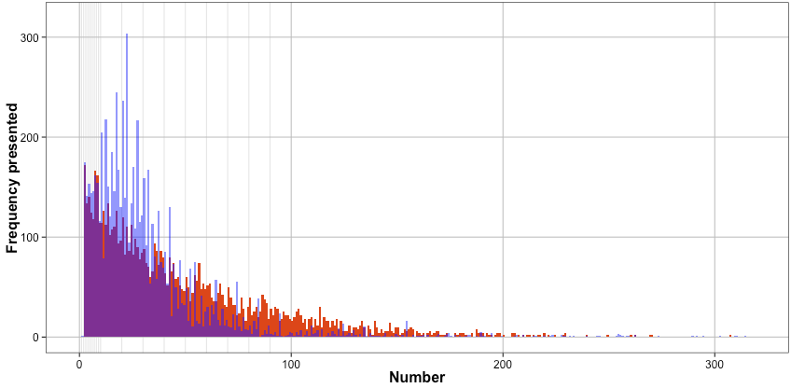
Presented
Reported
Reported numbers tend to…
Be underestimated
Be “round”

Slide 14
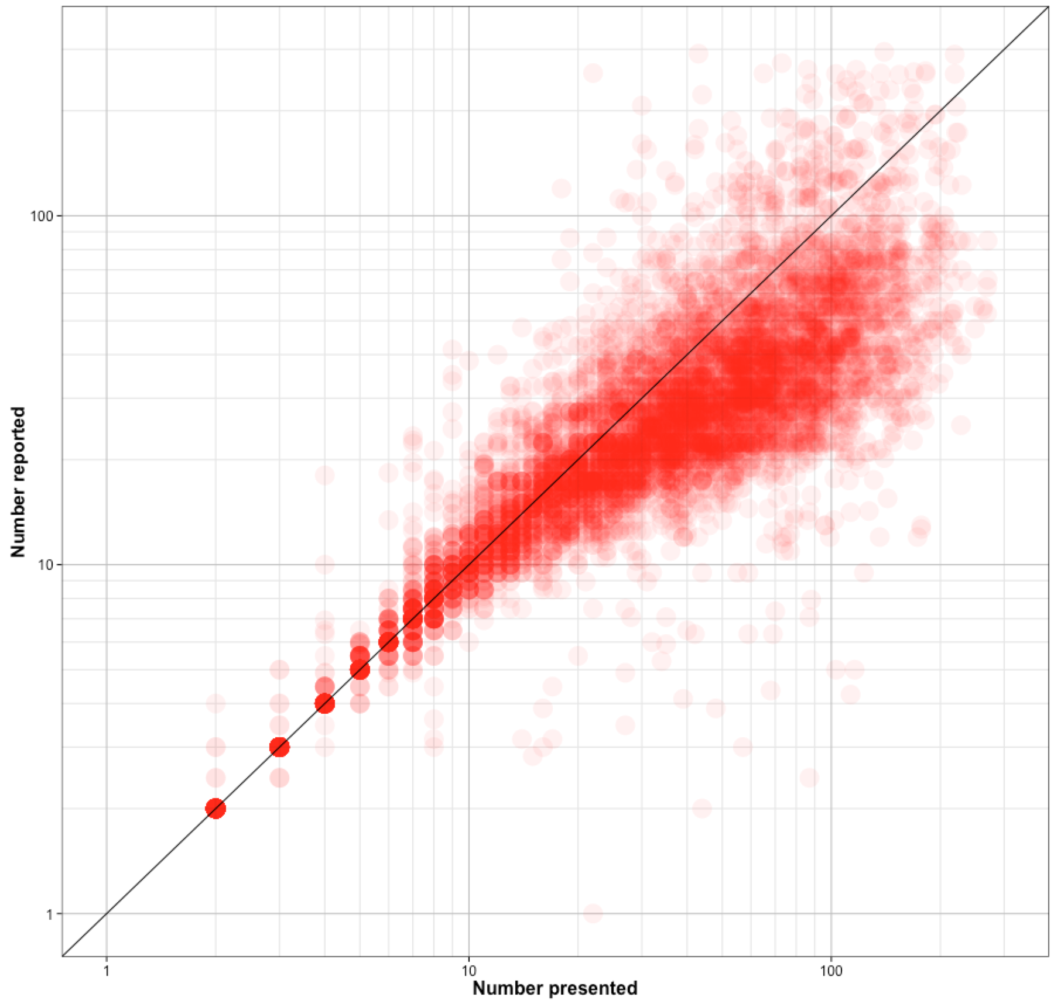

Slide 15
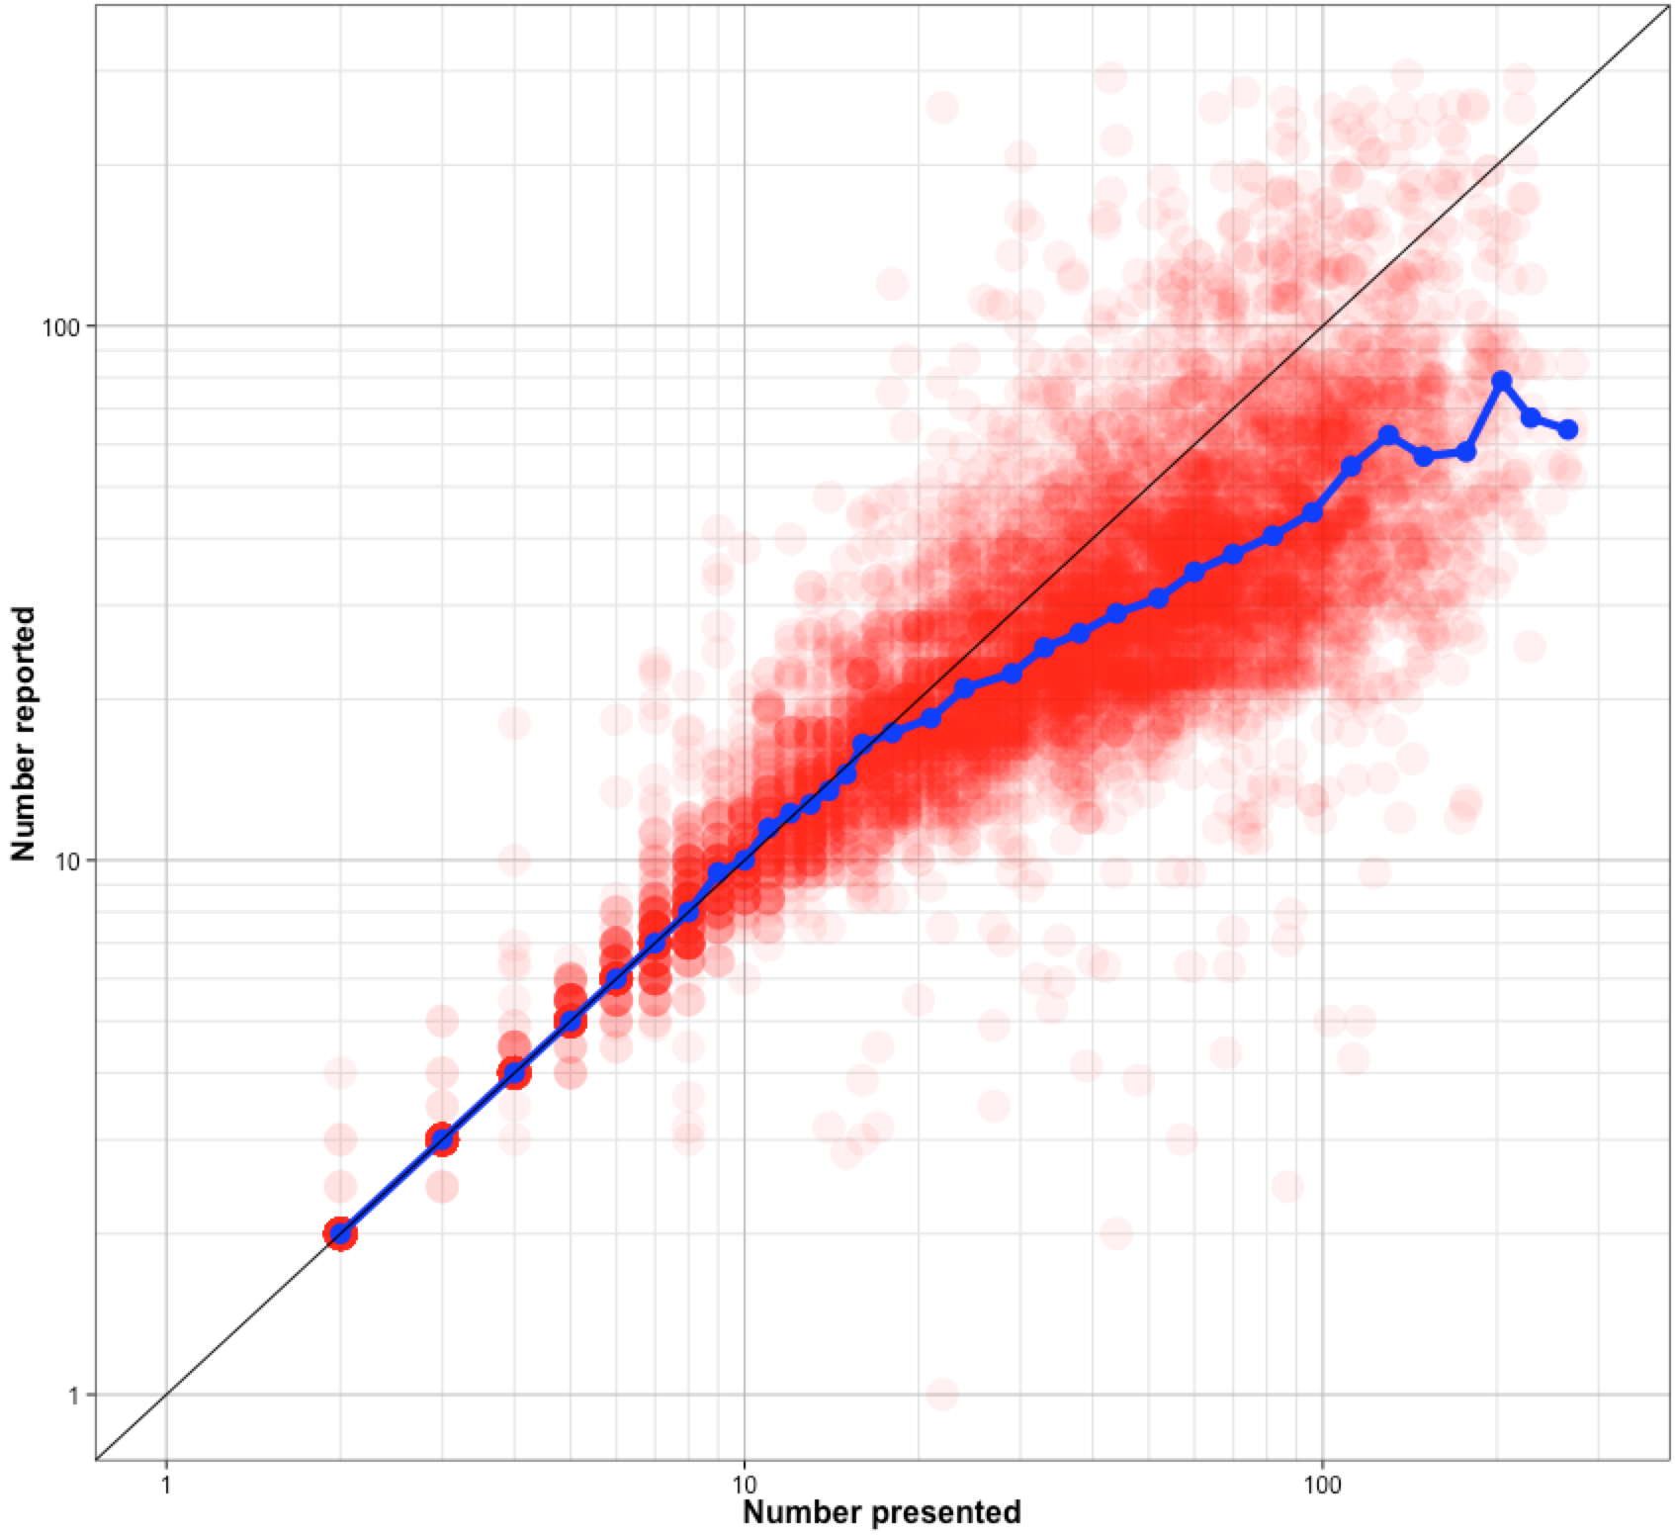
Individual trials
Median

Slide 16
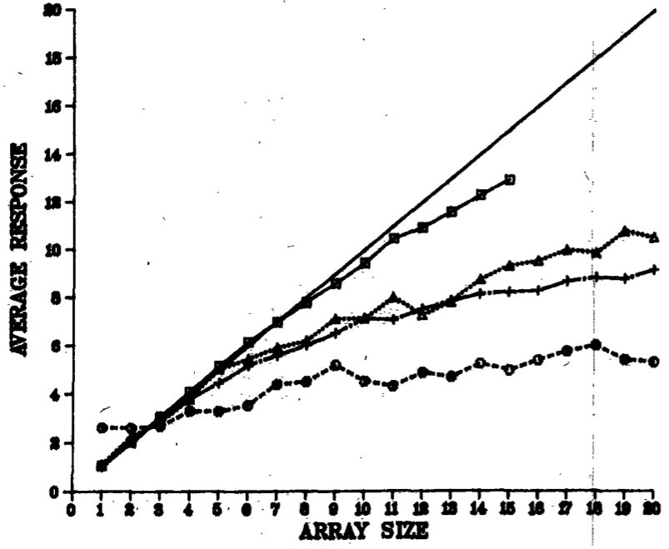
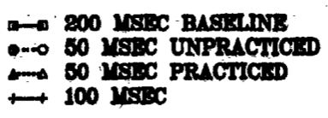
Individual trials
Median
Reported numbers tend to…
Be underestimated
Be quite noisy when large

Slide 17
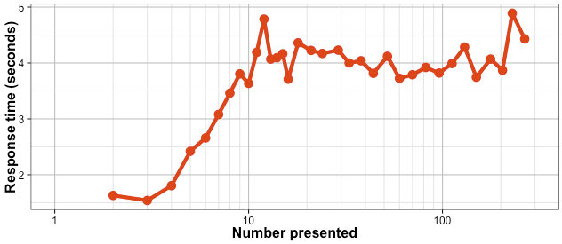
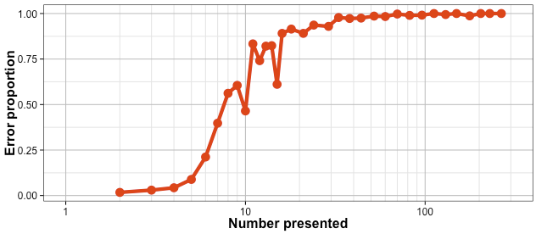
Individual trials
Median
“Subitizing”
Response Time
Error rate

Slide 18
Individual trials
Median

Slide 19
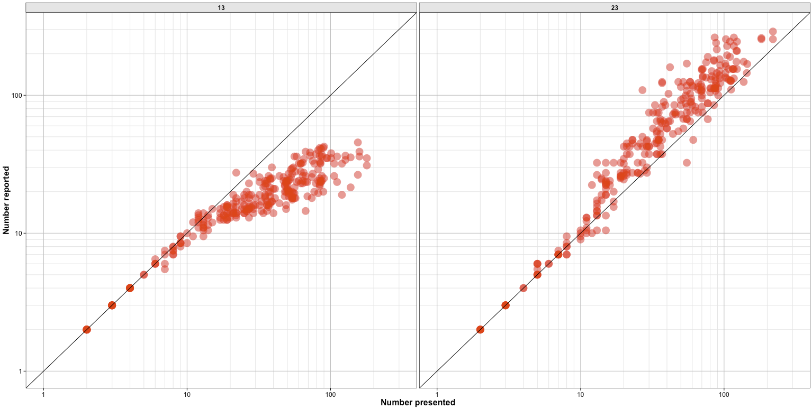
Some of the messiness seems to arise from individual differences.

Slide 20
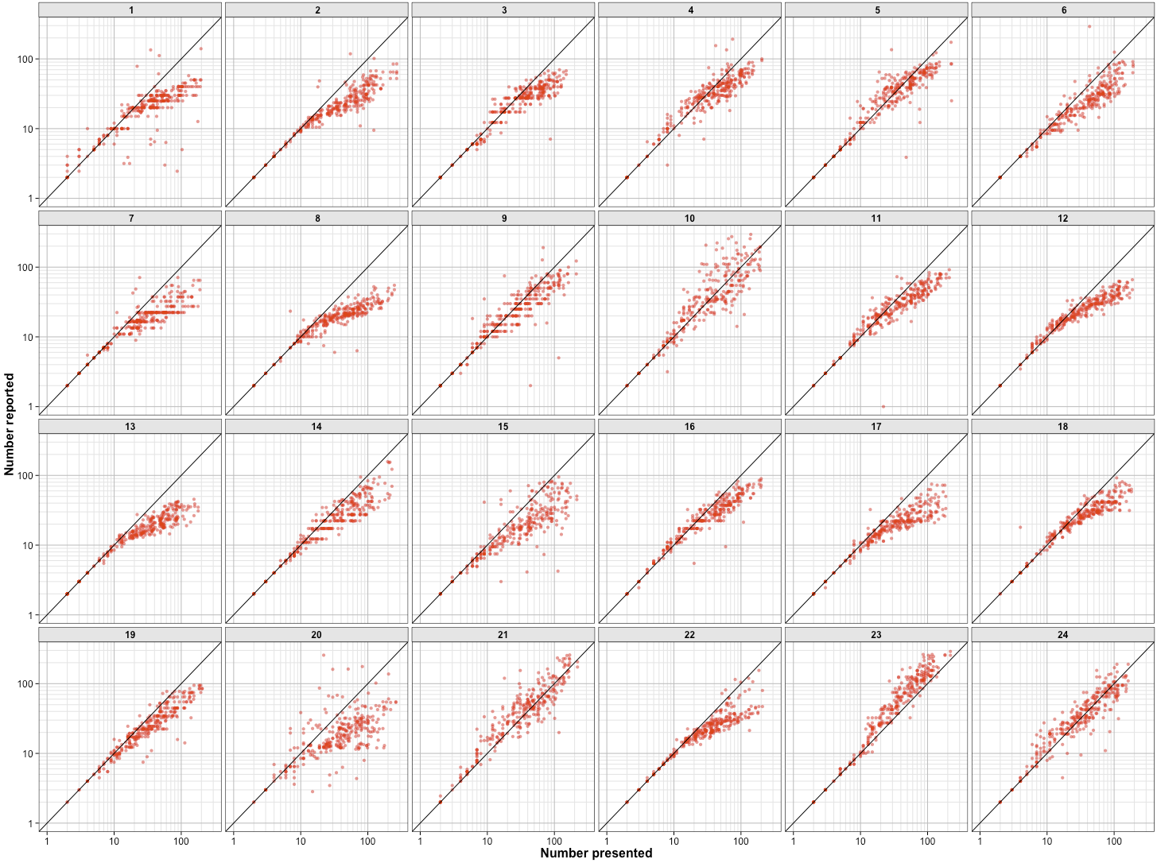

Slide 21
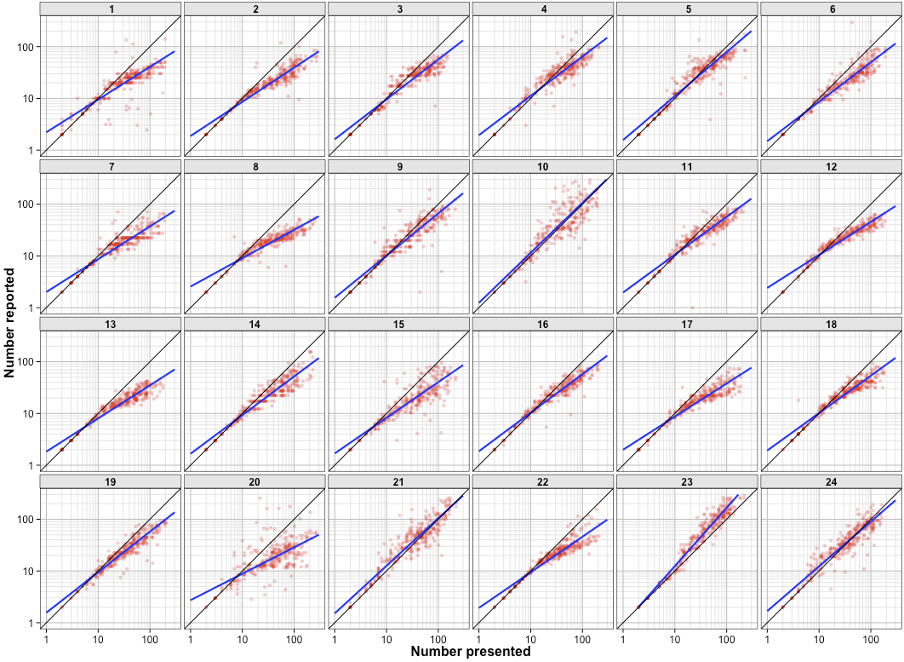

Slide 22
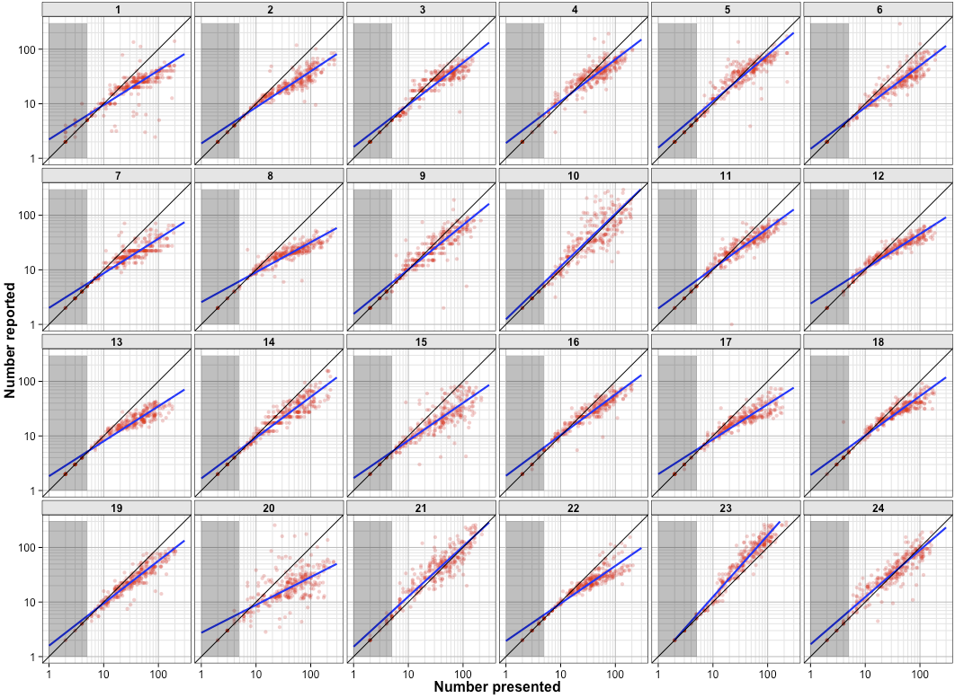

Slide 23
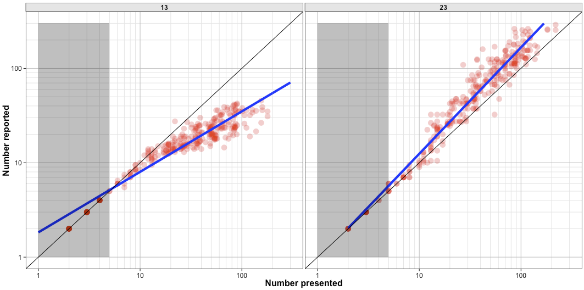
Calibration seems to extend far beyond the subitizing range...

Slide 24
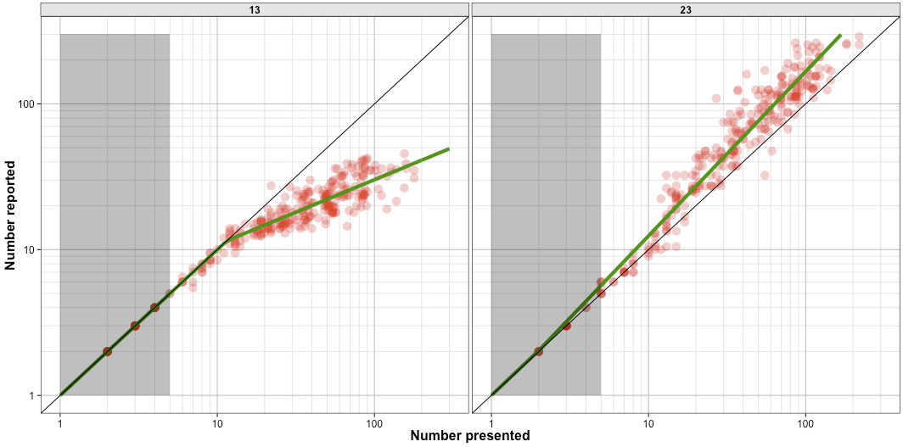
Bilinear power fits capture these deviations

Slide 25
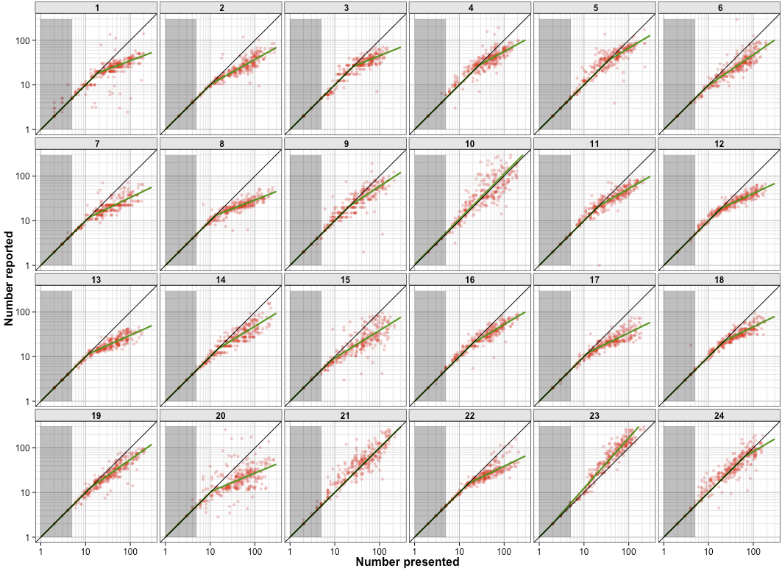

Slide 26
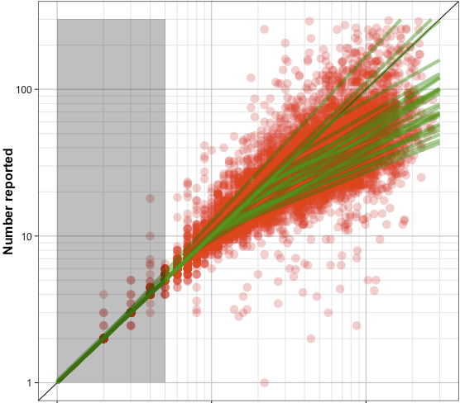
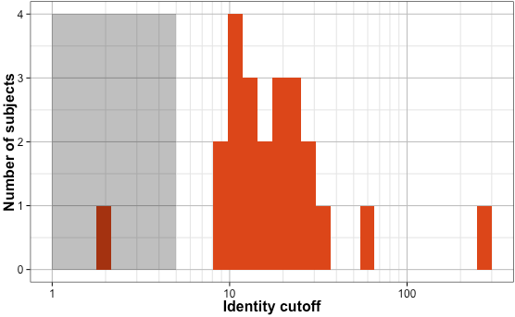
Most subjects have cutoffs around 10-30, well outside subitizing range.

Slide 27
“80”
How do we map the numerosity of an array onto a symbolic number?
Mapping isn’t a simple power law outside subitizing – instead it seems to show power-law miscalibration only for large numbers.

Slide 28
Ciccini, Anobile, & Burr (2014)
Does this time-dependence arise in number estimates?

Slide 29
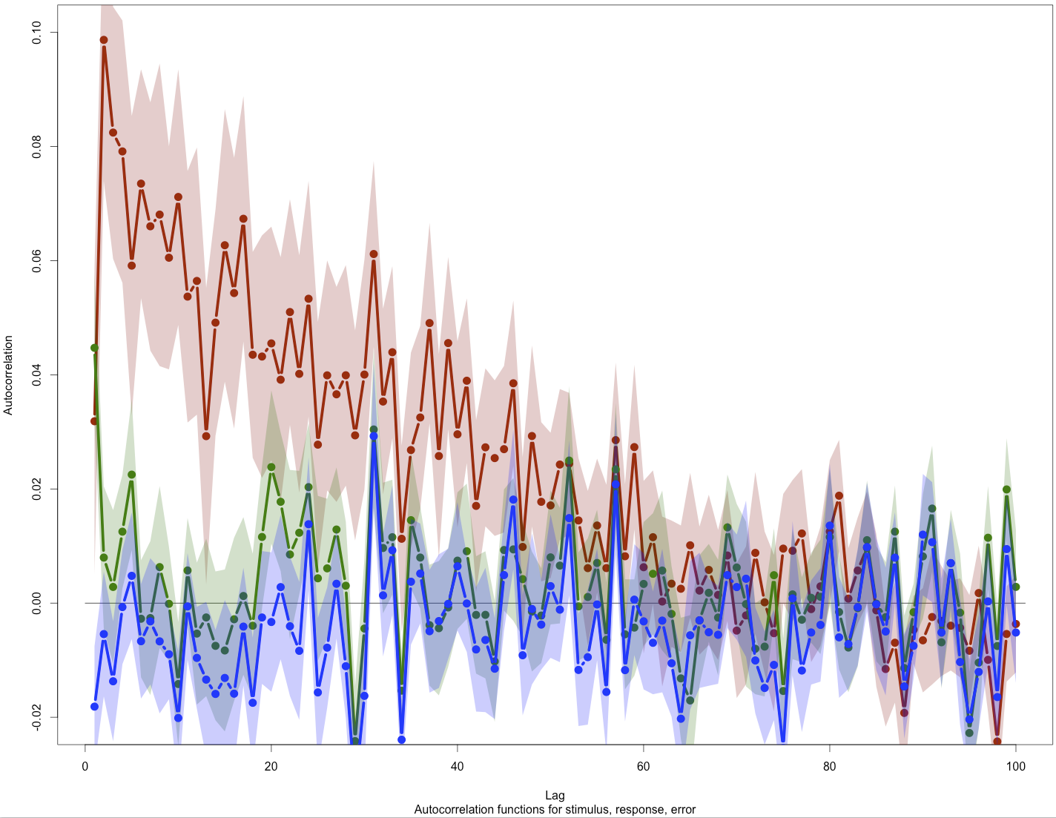
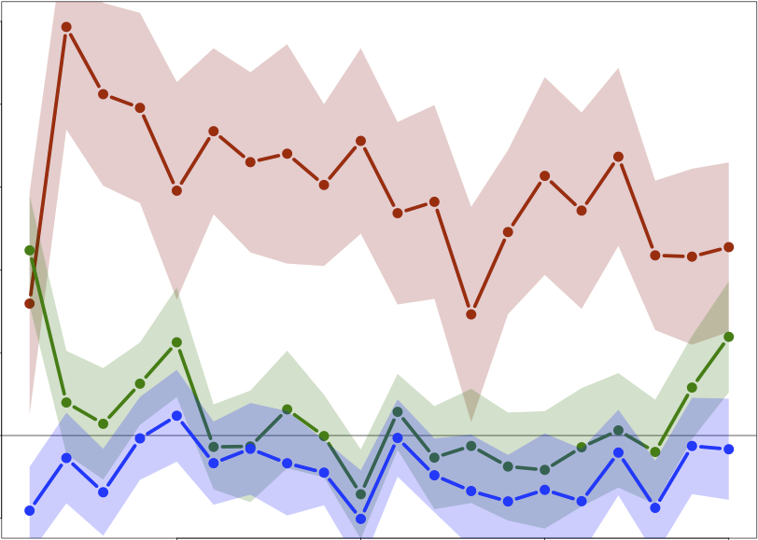
Responses
Stimuli
Error

Slide 30
Responses
Stimuli
Error
Ciccini, Anobile, & Burr (2014)
Does this time-dependence arise in number estimates?
Yes – there is a significant 1-back correlation, but it is negligible compared to the very long-lasting correlation of errors.
What’s up with those?

Slide 31
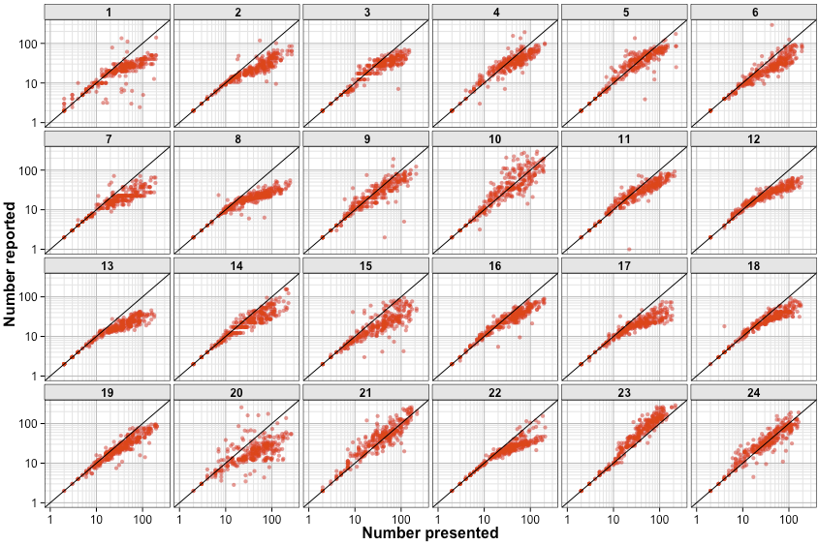
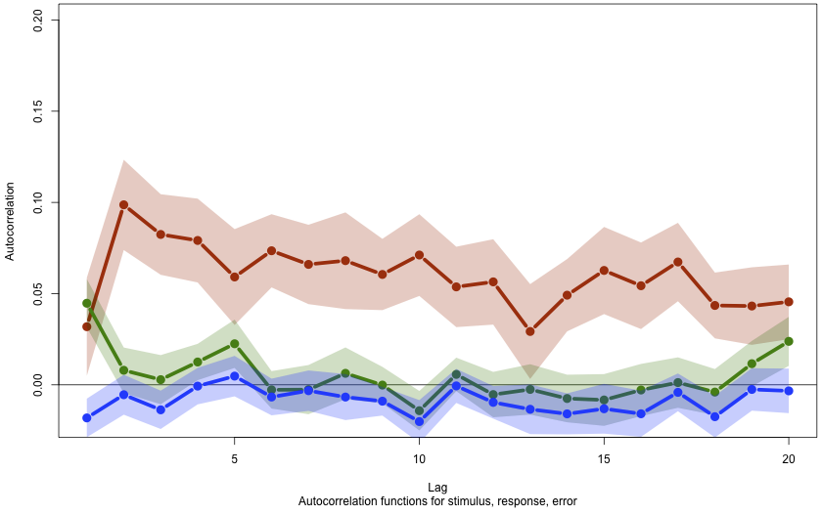
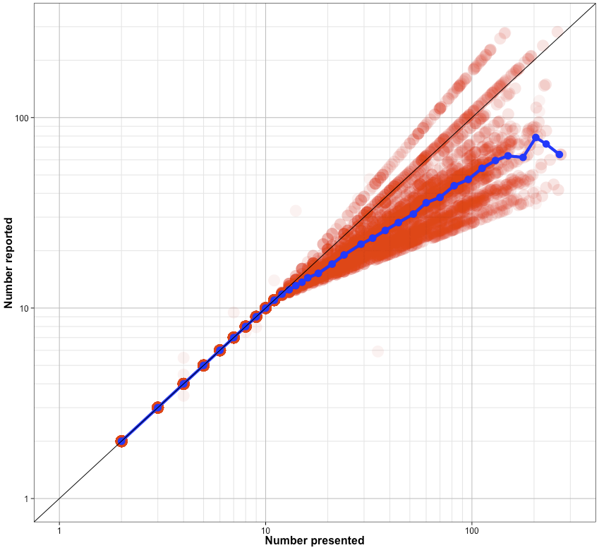
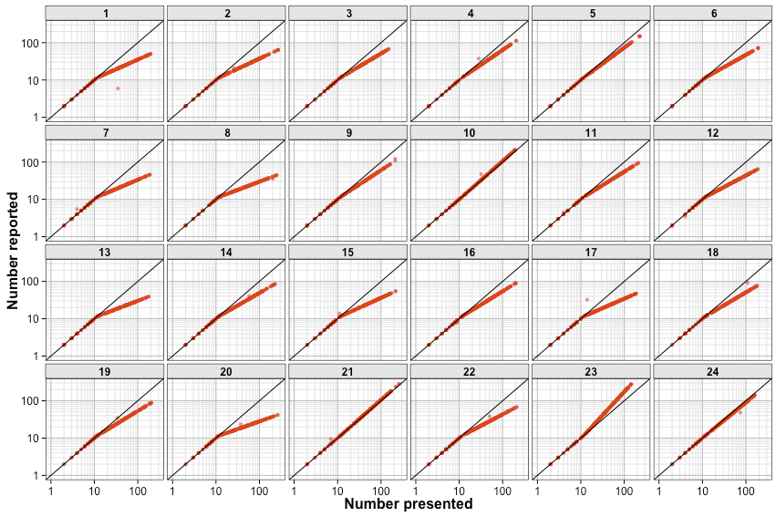
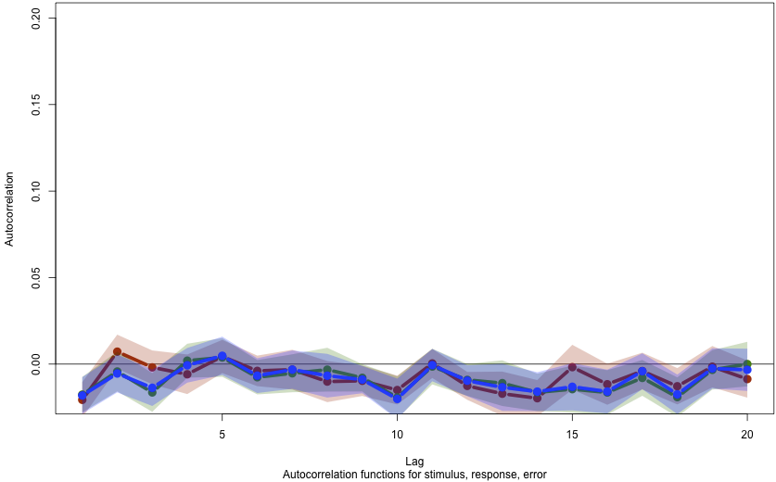
Real data
Static mapping

Slide 32
Ciccini, Anobile, & Burr (2014)
Does time-averaging cause the drift?

Slide 33
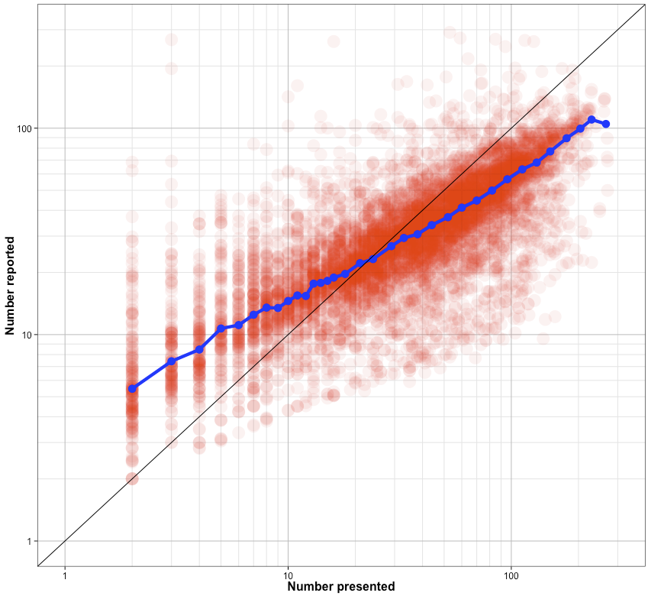
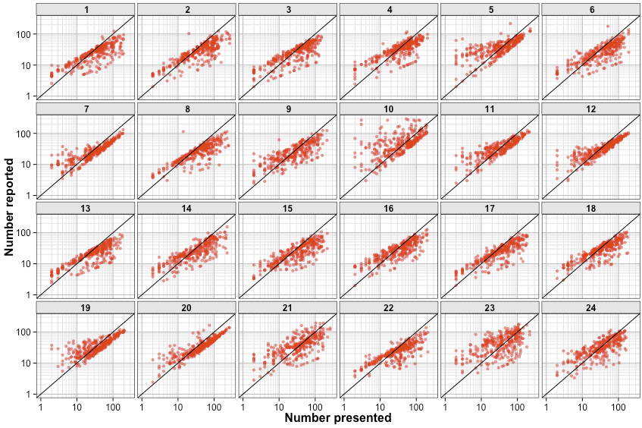
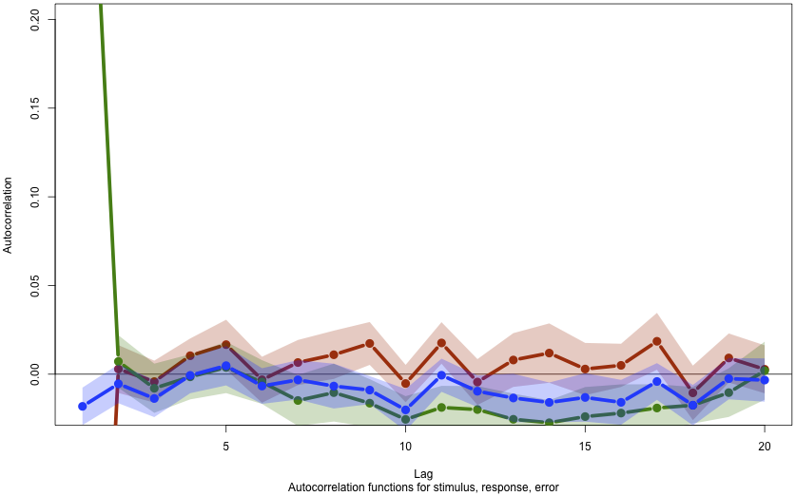
Real data
Static mapping
Burr response averaging
Ciccini, Anobile, & Burr (2014)

Slide 34
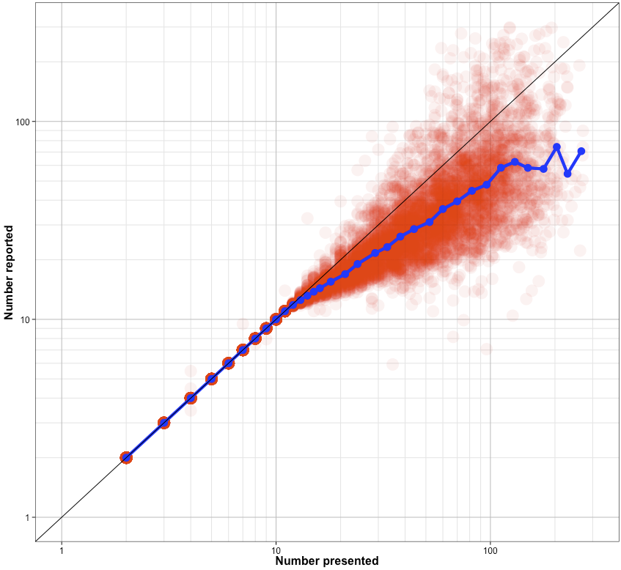
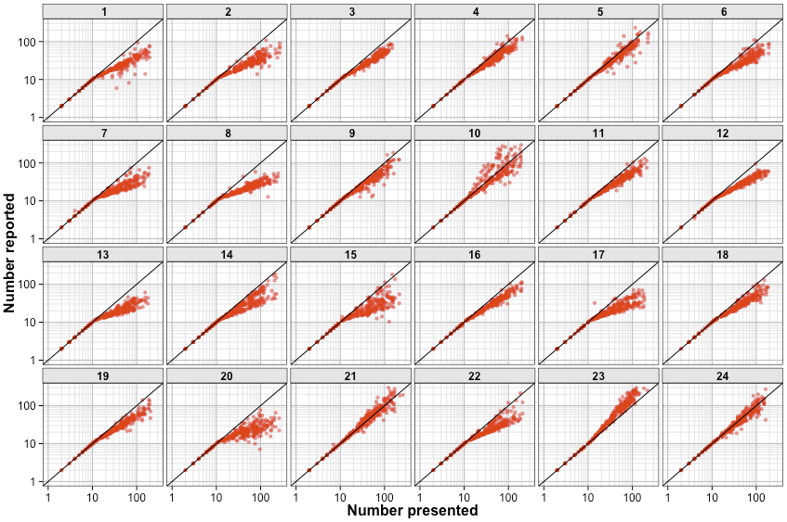
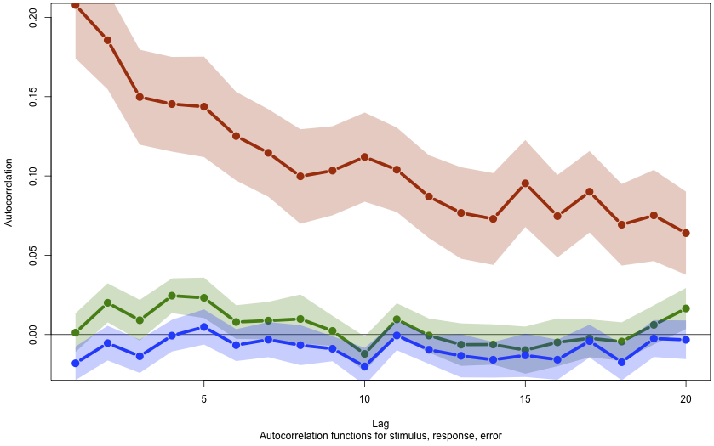
Real data
Static mapping
Burr response averaging
Dynamic mapping

Slide 35
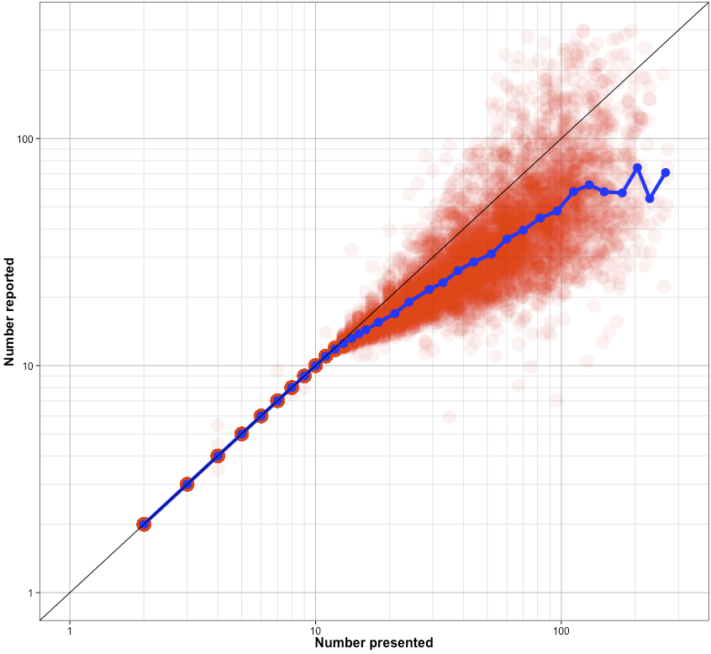

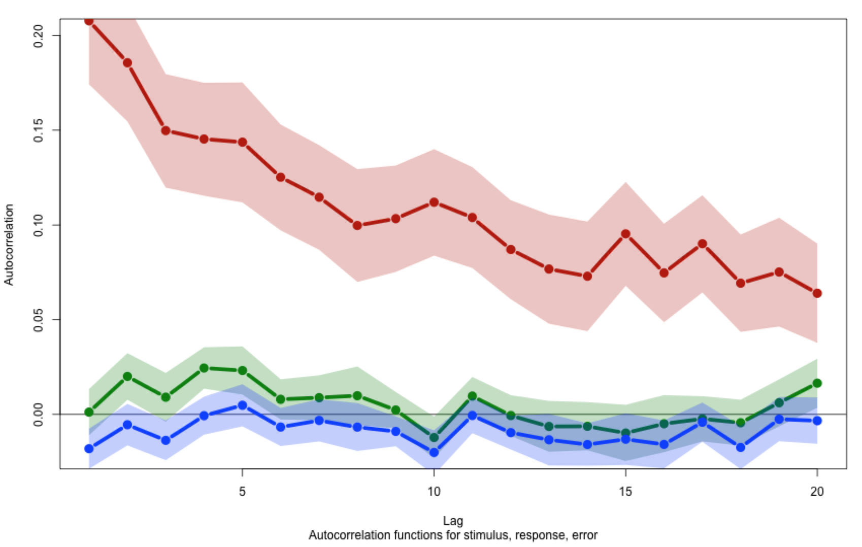
Error autocorrelation and considerable variability arises from continuously updating estimate of the mapping function.
Let’s explicitly evaluate the drift of the slopes in subjects

Slide 36

Split-half (modular) correlation: 0.95
Trials 1, 3, 5, 7, …, 299
Trials 2, 4, 6, 8, …, 300

Slide 37

Split-half (blocked) correlation: 0.83
Split-half (modular) correlation: 0.95
Trials 1-150
Trials 151-300
Huh? Maybe the magnitude-number mapping slope changes over time?

Slide 38


Split half-correlation:
2 “blocks” of 150 trials each
Split 30ths:
30 “blocks” of 10 trials each

Slide 39


Correlation of
slope estimates between each of 30 “10” trial blocks

Slide 40

Compare correlation across split-30ths at varying distances.
Blocked:
Distance 10:
- trials 1-10 vs trials 11-20
- trials 11-20 vs trials 21-30 …
Distance 20:
- trials 1-10 vs trials 21-30
- trials 11-21 vs trials 31-40 …
Distance 290:
- trials 1-10 vs trials 291-300
Modular (control):
“Distance 10”:
- trials {1, 31, …} vs trials {2, 32, …}
- trials {2, 32, …} vs trials {3, 33, …} …
“Distance 20”:
- trials {1, 31, …} vs trials {3, 33, …}
- trials {2, 32, …} vs trials {4, 34, …} …
“Distance 290”:
- trials {1, 31, …} vs trials {30, 60,…}
Reliability of slope estimates across splits
Distance (trials)

Slide 41
“80”
How do we map the numerosity of an array onto a symbolic number?
Mapping is bi-linear with calibrated range up to ~20.
Miscalibrated mapping seems to change slowly over time.
Calibration drifts as people update with own noise.***
Is this mapping the same for different stimuli?

Slide 42

500

Slide 43





Area
Size
Spacing
25 trials with (calibrated) feedback, then lots (up to 975) more without

Slide 44

Presented
Reported

Slide 45

Responses
Medians

Slide 46

n = 50
n = 500

Slide 47

Calibrated feedback
After the initial 25 calibrated feedback trials, people gradually drift out of calibration.

Slide 48

After the initial 25 calibrated feedback trials (block 1), people gradually drift out of calibration.

Slide 49


Slow drift in slopes here too,
even though we start off calibrating…

Slide 50

size
space
area

Slide 51




Correlation
Feedback [block 0]
Trials (1-25)
size-space
size-area
space-area
No feedback block 11
Trials 276-300
No correlation between slope estimates with feedback (because too little real variation in slope estimates*) this correlation grows as people drift out of calibration

Slide 52

size-size
density-density
area-area
size-density
size-area
space-density

Slide 53

size-size
space-space
area-area
size-space
size-area
space-area
Correlation of slopes at different distances is indistinguishable within and across stimulus types

Slide 54
“80”
How do we map the numerosity of an array onto a symbolic number?
Mapping is bi-linear with calibrated range up to ~20.
Miscalibrated mapping seems to change slowly over time.
Calibration is short-lived.
Miscalibration is shared across stimulus types.
Calibration drifts as people update with own noise.***
Thanks

Slide 55


Slide 56

200

Slide 57


Slide 58


Slide 59


Slide 60

Feedback
1.1 – 0.9
0.9 – 1.1

Slide 61


Slide 62


Izard & Dehaene (2008)

Slide 63





Slide 64


Izard & Dehaene (2008)

Slide 65

What are the sources of error?
Weber noise on internal magnitude estimates, plus stable linear miscalibration.
Izard & Dehaene (2008)

Slide 66



0.5
1.0
1st
2nd
3rd
1st
1.0
0.4
Blocked
2nd
Split nth reliability
(slope correlation)
3rd
1st
2nd
3rd
Modular split
1st
Blocked split
0 300
Distance between nths (trials)
Modular
2nd
3rd

Slide 67





Slide 68

Kahneman & Tversky (1979)

Slide 69


Linearity of number-space mapping varies with culture.
Dehaene, Izard, Spelke, & Pica (2008)

Slide 70



Precision of comparing the numerosity of two arrays predicts subsequent general mathematics ability.
Halberda, Mazzocco, & Feigenson (2008)

Slide 71

This makes a few assumptions:
We have a “numerosity representation” (rather than simply a stimulus representation)
Our numerosity representation is general and comparable across lots of stimuli.
The numerosity representation is not a symbolic number
This sidesteps a few issues:
Is numerosity extracted from basic visual features, or is it a visual feature itself?
This leads to a few questions.
How do we go from stimulus to the internal magnitude estimate?
How do we map the magnitude estimate onto numbers?
“80”

Slide 72



“blue<red”

Slide 73


Kaufman, Lord, Reese, Volkmann (1949)
Notes:
7

Slide 74

Kaufman, Lord, Reese, Volkmann (1949)
Notes:
28

Slide 75

Kaufman, Lord, Reese, Volkmann (1949)
Notes:
89

Slide 76
Kaufman, Lord, Reese, Volkmann (1949)

Slide 77

Mandler, Shebo (1982)

Slide 78

Atkinson, Campbell, Francis (1976)

Slide 79




Whalen, Gallistel, Gelman (1999)

Slide 80




Slide 81



Slide 82
Izard & Dehaene (2008)

Slide 83

Presented
Area
Size
Spacing

Slide 84


Slide 85


Slide 86


Slide 87


size-size space-space area-area size-space size-area space-area

Slide 88


Having a formal system (e.g. number words) facilitates analog tasks.
Frank, Everett, Federenko, & Gibson (2008)
Frank & Barner (2012)

Slide 89


blue > red
Piazza, Pica, Izard, Spelke, & Dehaene (2013)
Halberda, Mazzocco, & Feigenson (2008)
Precision (Weber-fraction) of numerical magnitude increases with education and predicts general mathematics ability.

Slide 90



Siegler & Opfer (2003)
Number-space mapping is logarithmic/power in youth, and linearizes with education.

